Slide 1

Brain Imaging Analysis and Reporting System (Image based brain tumor detection using deep learning )
Group Members
Abdul Mohaiman (20P-0580)
Haris Ali (20P-0142)
Nazim Sulman (20P-0639)
Project Supervisor
Dr. Hafeez Anwar

Slide 2
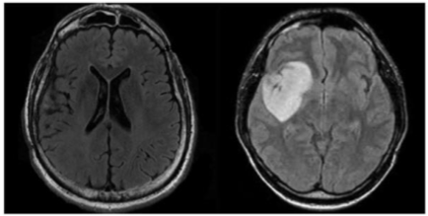
Introduction
Deep Learning with MRI Imaging
Methodology Overview:
Dataset acquisition
Preprocessing MRI scans
Training Deep learning models
Achieve brain tumor detection

Slide 3
Motivation
Address the need to revolutionize brain tumor detection which currently burden healthcare systems globally.
Manual interpretation of brain scans is slow, labor-intensive, and prone to errors despite advancements in imaging technology.
Implementation of deep learning based approaches could lead to quicker interventions and better outcomes for patients brain tumor detection.

Slide 4
Literature Review
Sr No | Year | Title | Methodology | Limitation
1) | 2020 | Brain Tumor Identification and Classification of MRI images using deep learning techniques | Limited evaluation on real-world datasets and potential scalability issues. | The paper proposes a deep learning-based approach for video anomaly detection using spatio-temporal feature extraction and reconstruction.
2) | 2022 | Brain Tumor Classification and Detection Using Hybrid Deep Tumor Network | The paper presents a novel method for brain classification using machine learning algorithms and feature extraction techniques. | Limited validation on diverse datasets from different geographical locations and grid conditions.
3) | 2022 | Brain tumor MRI images identification and classification based on the recurrent convolutional neural network | Utilizes deep learning algorithms for semantic segmentation of brain tumor regions in MRI images. | May not account for potential variations in tumor appearance and characteristics across different patient populations.
4) | 2023 | Brain Tumor Detection and Classification Using Deep Learning and Sine-Cosine Fitness Grey Wolf Optimization | The paper employs a convolutional neural network (CNN) to classify brain tumor types using MRI images. | The study may be limited by the availability and quality of the MRI dataset used for training the CNN.

Slide 5
Problem Statement
Timely, accurate brain tumor detection via enhanced MRI images using deep learning can improve diagnosis and treatment efficiency,overcoming limitations of traditional methods and radiologist dependence.

Slide 6
Solution
Comprehensive web-based software solution addressing the challenges in brain tumor detection.
It will encompass both front-end web development and seamless integration of Deep learning model for brain tumor detection.

Slide 7
UML Diagrams

Slide 8
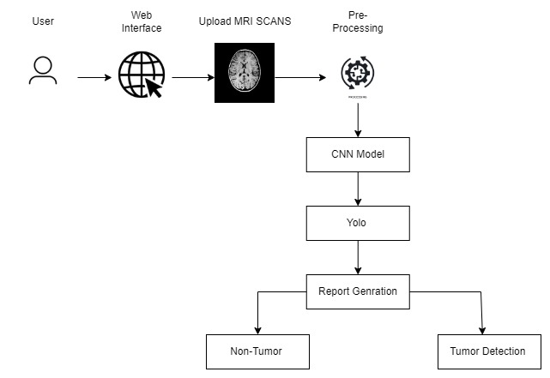
System Architecture

Slide 9
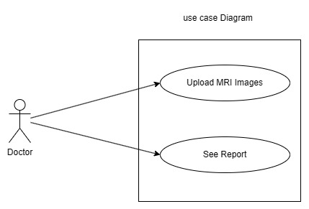
Use Case Diagram

Slide 10
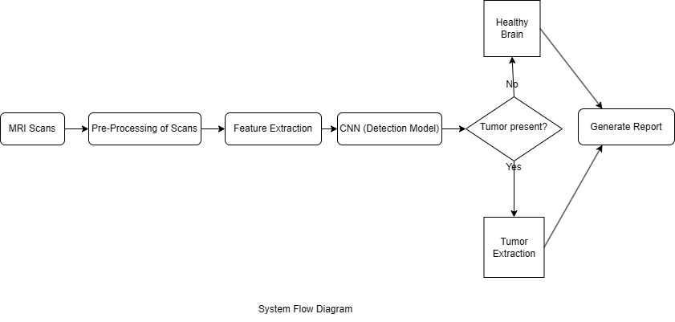
Flow Diagram

Slide 11
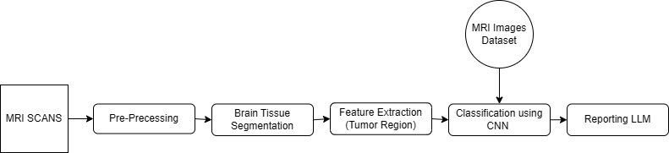
Block Diagram

Slide 12
Scope of the project
This project will greatly impact the medical field by introducing advanced techniques such as deep learning algorithm for image based brain tumor detection.
It aims to simplify decision-making for doctors for the treatment of patients.

Slide 13
Goals
Develop a user-friendly software to facilitate easier tumor detection for doctors, aiding in decision-making by precisely identifying abnormalities in brain images and pinpointing the location of tumors.

Slide 14
Dataset

Slide 15
Dataset
Dataset is sourced from kaggle majorly and from hospitals which were easy to share there patient data.
Date set contain scans of different types of Brain tumor Glioma. Pituitary Adenoma , Meningioma etc.
Dataset contain approximately 7000+ MRI scans for testing and training of CNN model for detection of tumor.

Slide 16
UI/UX

Slide 17
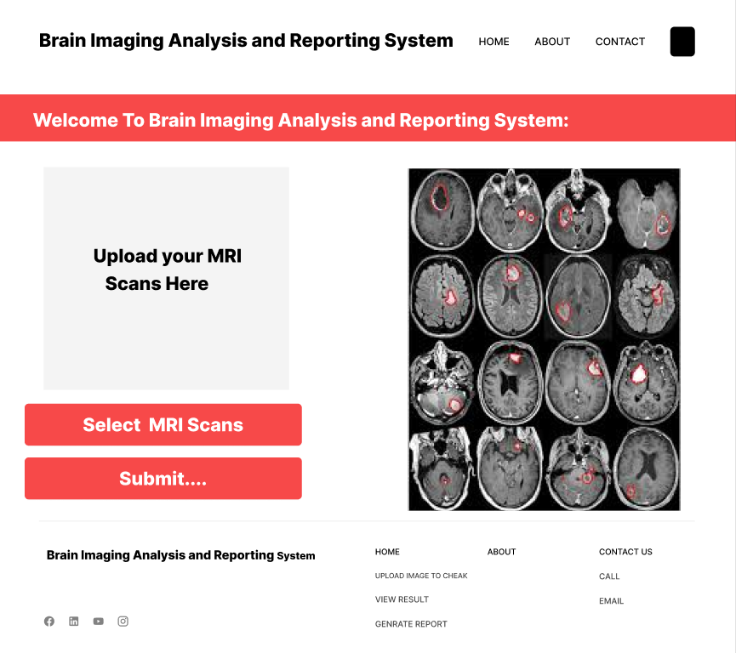
Home Page

Slide 18
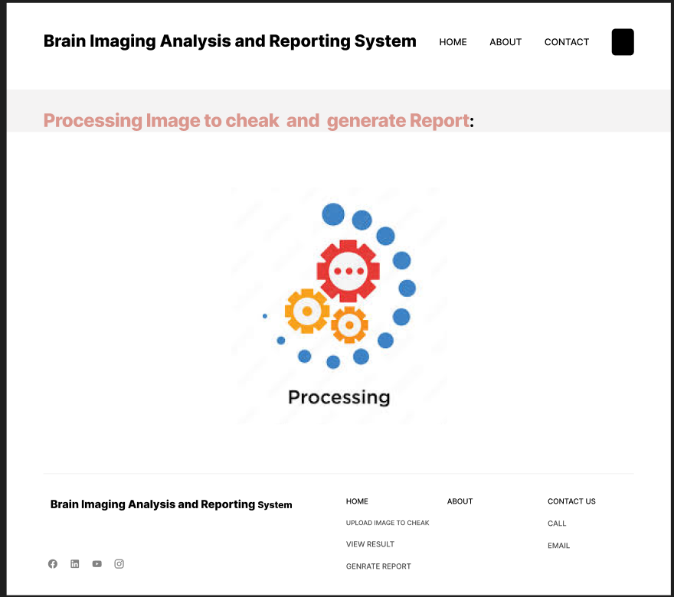
Processing.

Slide 19
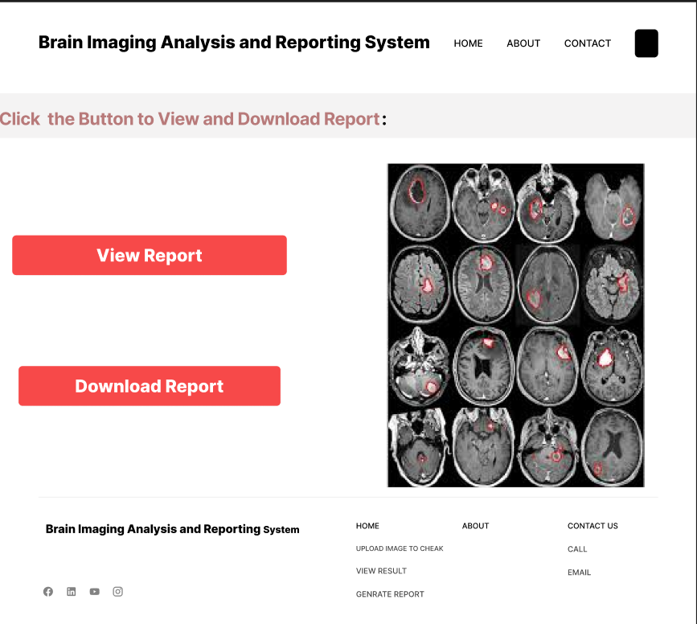
Report page:

Slide 20
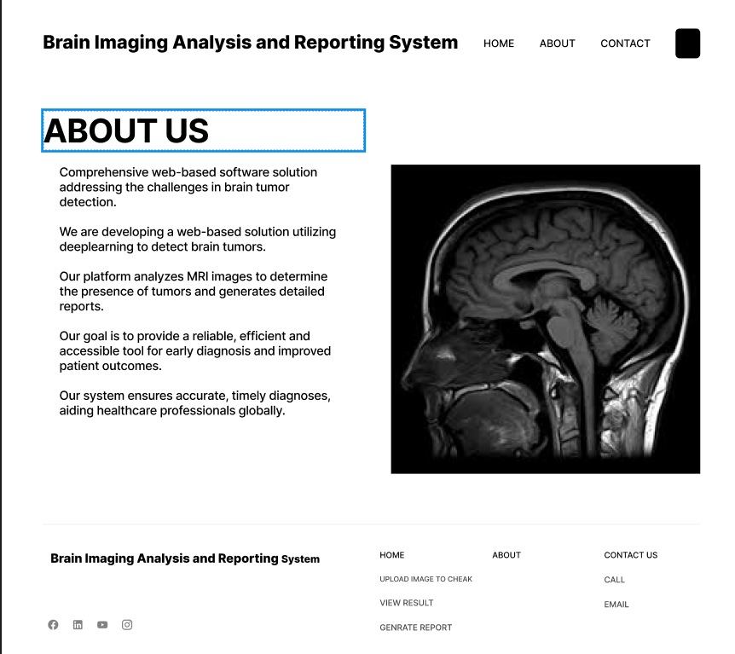
About Page:

Slide 21
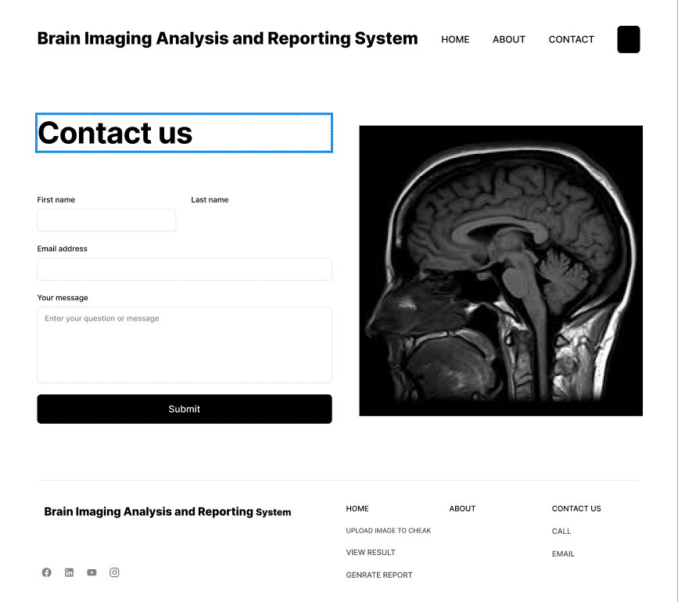
Contact Page:

Slide 22
Web Prototype

Slide 23
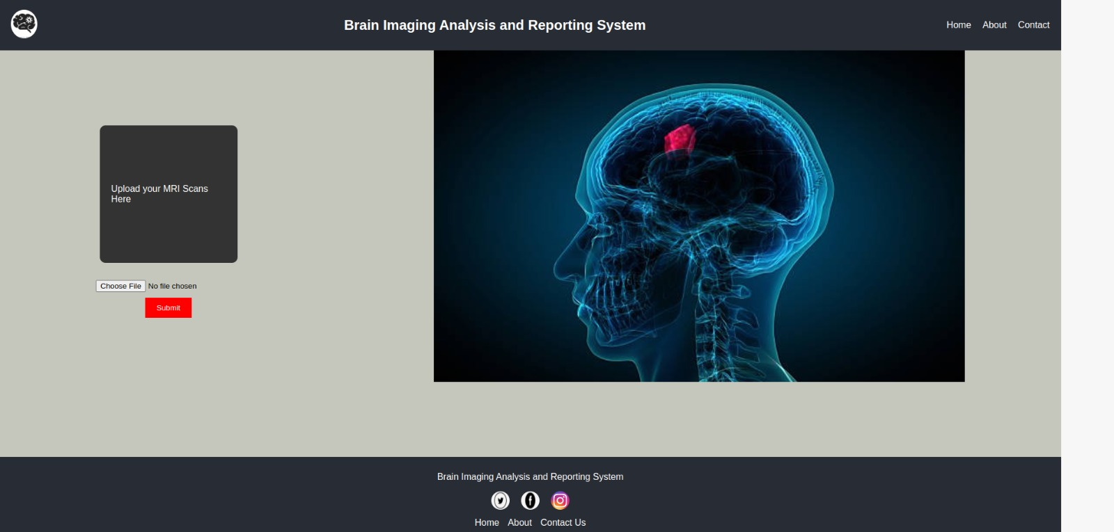

Slide 24
Model Results

Slide 25
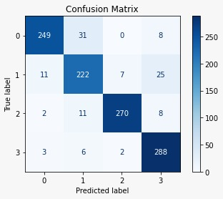
Confusion Matrix

Slide 26
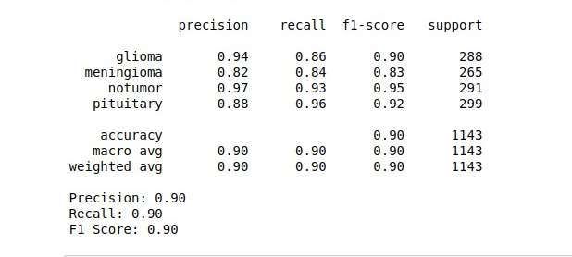
Accuracy

Slide 27
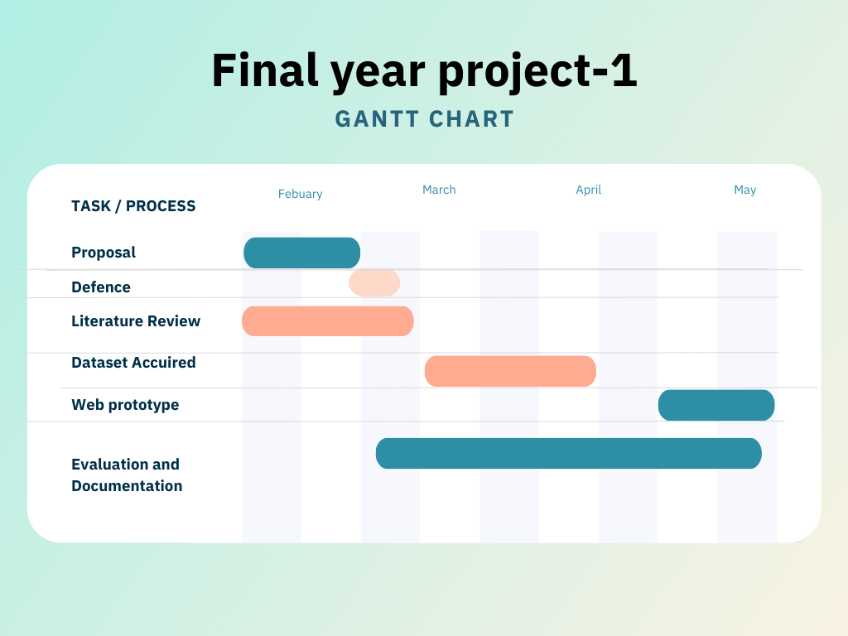
Objectives

Slide 28
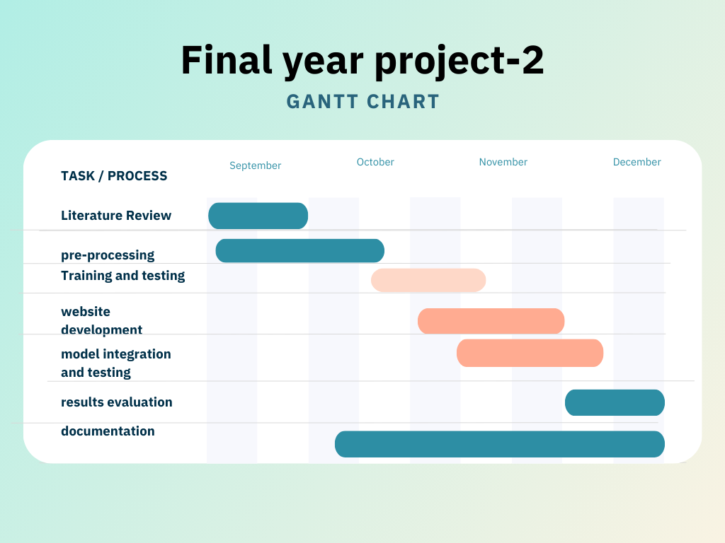
Objectives

Slide 29
Expected Result
At the completion of this project we will see a complete Web based software which will be helpful in brain tumor detection using Deep learning algorithms.

Slide 30
Team Work
We finalized our idea.
The documentation and literature review will be done equally.
The collection of MRI scans and dataset by Haris.
Ensuring proper data labeling and annotation and performing data preprocessing and classification done sulman and Haris.
Normalizing and data augmentation by sulman.
Designing a prototype of web based application by nazim sulman.
Project documentation, Preparing figures for presentations and reports and SDA diagram by Haris and Mohiman.

Slide 31
References
Zheshu Jia, "Brain Tumor Identification and Classification of MRI images using deep learning techniques " IEEE Access, 2020.
A. Smith, “Brain Segment Classification on anomaly detection Using Machine Learning Techniques" IEEE Access, 2022.
Deyun Chen, "Deep Learning-Based Semantic Segmentation for Brain Tumor Detection in MRI Images," IEEE Transactions on Medical Imaging, 2022.
Nael M Alwandi, "Automatic Brain Tumor Classification Using Deep Learning With Convolutional Neural Networks." IEEE Access, vol. 9, 2021.

